Slide 1
Business and Industrial Economics
A.Y. 2023/2024
Prof. Mattia Pedota
Strategic Interdependence and Game Theory Basics

Slide 2
Introduction
Are there alternative perspectives?
How do firms evolve?
Neoclassical profit maximization logic
Structure-conduct-performance paradigm
Formal structural models of competition:
Perfect competition; Monopoly; Oligopoly

Slide 3
Introduction
Number of companies N
Perfect competition
Oligopoly
Monopoly
The term Oligopoly means (from Greek): oligos=few; polein=sell
The number of companies in the market, N, is small
The behavior of each firm significantly affects the behavior of other firms, which leads to strategic interdependence

Slide 4
Basic analytical tools
What tools do we need?
Neoclassical profit maximization logic → profit maximization rule
Strategic interdependence → game theoretical insights

Slide 5
Basic analytical tools
Game theory is the formal modeling of optimal decision-making in contexts of strategic interaction.
In its simplest version (simultaneous game, two players, pure strategies):
There are 2 players
Each player has a set of possible actions, which may be discrete or continuous.
Different combinations of actions unambiguously determine different outcomes.
Each outcome is unambiguously associated to a pay-off for each player.
Players are perfectly rational and perfectly informed.
Players decide their actions simultaneously, aiming for pay-off maximization.

Slide 6
Basic analytical tools
Let’s define two key concepts:
1) Reaction function: function associating each possible strategy of one player with the optimal response of the other player.
2) Nash equilibrium: configuration of strategies where each player’s strategy is the best response to the strategy of the other player. A configuration of strategies is a Nash equilibrium if no player could improve the resulting pay-off by unilaterally deviating from the selected strategy.

Slide 7
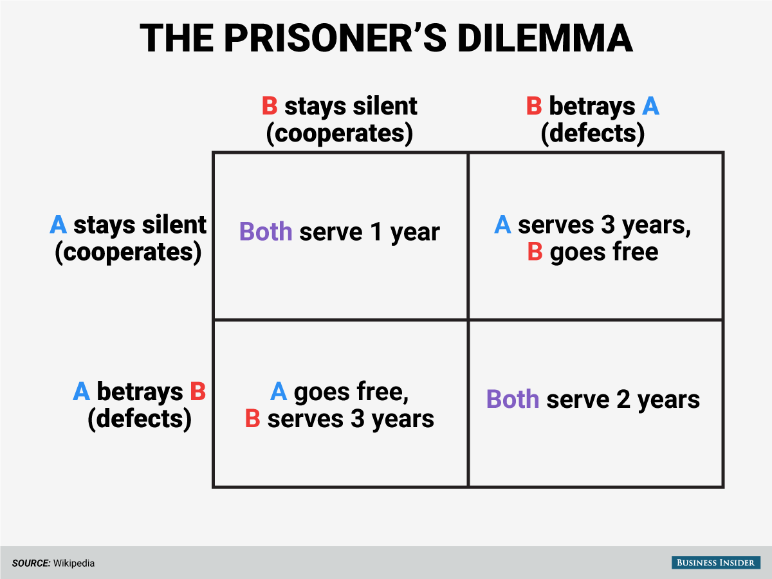
A discrete example
A stays silent → B betrays B stays silent→ A betrays
A betrays → B betrays B betrays → A betrays
A betrays ←→ B betrays is the only Nash equilibrium

Slide 8
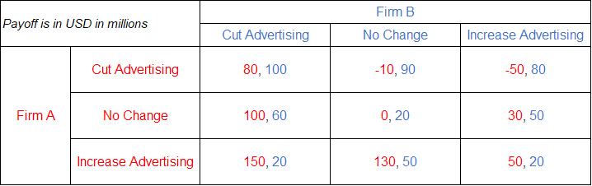
A discrete example
A cut → B cut B cut → A increase
A no change → B cut B no change → A increase
A increase → B no change B increase → A increase
A increase ←→ B no change is the only Nash equilibrium

Slide 9
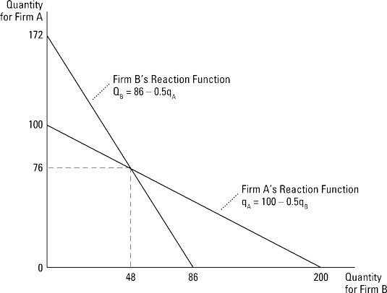
A continuous example

Slide 10
A variant: sequential games
In sequential games (simplest version):
There are 2 players
Each player has a set of possible actions, which may be discrete or continuous.
Different combinations of actions unambiguously determine different outcomes.
Each outcome is unambiguously associated to a pay-off for each player.
Players are perfectly rational and perfectly informed.
Players decide their actions sequentially, aiming for pay-off maximization. The player acting first is known as the leader, while the other is known as the follower.

Slide 11
Solving sequential games
Solving sequential games
Discrete sequential games are typically represented as decision trees.
Sequential games can be easily solved by backward induction: you start by determining the pay-off maximizing strategy of the follower. Then, you base the strategy of the leader on this information.
The sequence of optimal actions obtained through backward induction is known as subgame perfect Nash equilibrium.

Slide 12
Sequential games: a discrete example
Two-stage sequential game of entry deterrence:
Entrant
Enter
Stay out
Incumbent
0, 10
Price war
Acquiescence
-5, -5
5, 5

Slide 13
Types of oligopolistic models
Models can be:
1. Collusive (e.g. cartel)
2. Competitive (Bertrand, Cournot, Stackelberg).
Simultaneous models (Bertrand, Cournot).
Sequential models (Stackelberg).
Key variables:
Prices set by each company (Bertrand)
Quantities offered by each company (Cournot, Stackelberg)

